Slide 1
BIT 6113
Database Management System
Sushil Bhattarai
sushil.bhattarai@texascollege.edu.np
Lincoln University College, CN 1221

Slide 2
Data
Facts
Statistics
Unorganized Numbers or Text or Symbols.
Name, age, height, weight, etc. are data related to a person.
Bank account number, Citizenship Number, License Number are data related to the person.
These data can be in the format of Picture, Image, File, Document, Text, Number, etc.
Data if arranged relationally and processed, it then becomes information.
Generate information from data
Name | Height(ft)
Ram | 4.9
Shyam | 5.2
Hari | 5.1

Slide 3
Database
Data could be random.
These data can be collected or stored in Database.
Data gets updated, expanded and deleted.
Database System makes data management easy.
Most of the application that deals with data has database systems for storing and accessing data.
A database has multiple tables to store data.
Data are stored in tables in rows and columns.

Slide 4
Importance of Data
Find Solutions To Problems
Create strategies
Access The available Resource
Keep track of everything inside an Organization
Make The Most Of Money

Slide 5
Distributed Database & Relational Database
Size
Is huge data supported?
Accuracy
Are there chances of entering incorrect data?
Security
Should the data be visible to everyone who access the file?
Redundancy
Is data repeated?
Inconsistency
Is data same on each copies?
Importance
computer crashes…?
Atomicity
Transaction should either happen or do not happen at all.

Slide 6
Why use Database?
1. store, manipulate, and extract information.
2. reduce the repeated storage of the data and improve the disk space.
3. keep up-to-date and correct information.
4. automate the overall process of managing and processing the system.
5. centralize the data and improve the security of the data.
6. generate reports based on stored data.
7. relations can be maintained across multiple data sets.

Slide 7
Data Management
involves collecting, storing, organizing, protecting, verifying, and processing essential data and making it available when needed.
ensures data in corporate systems is accurate, available and accessible.
result in better analytics.
Result in efficient data store and retrieve.
A managed data makes good use of available hardware and software resources.
Helps reduce the security risks and prevent data loss.
Help make the accurate decision by processing data efficiently.

Slide 8
How Data are stored in Database
Primary objective of database is to store and retrieve data when needed.
Data is stored in tables.
Single database consists of multiple tables
Single table consists of multiple rows and columns.
Table is the most basic building block of a database.
A table contains data, along with the definition of data type of each column.
A table can have relationship with the other tables.
columns define what the data should be in the table
rows hold the actual values

Slide 9
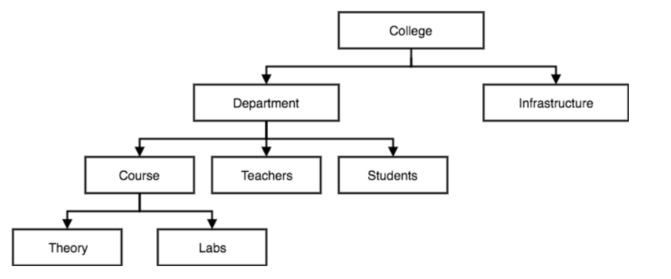
Different Database Models
Relational Model
Hierarchical Model
Network Model
Object-oriented Model
Hierarchical Model
Organizes data into a tree-like-structure, with a single root
Hierarchy starts from the Root data, and expands like a tree, adding child nodes to the parent nodes
A child node will only have a single parent node
Data is organized with one one-to-many relationship between two different types of data

Slide 10
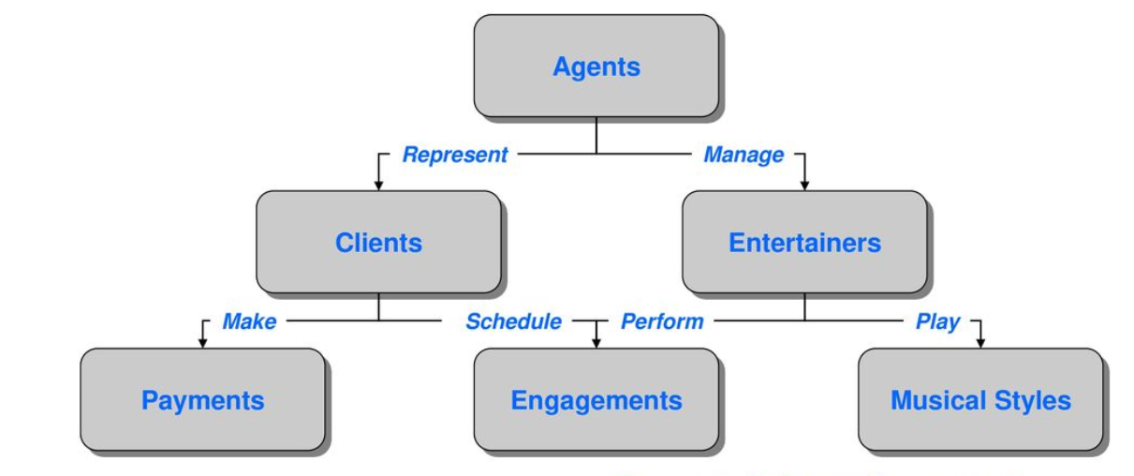
Network Model
Data is organized more like a graph, and have more than one parent node
Accessing the data is also easier and fast as data can be related from multiple nodes
Maps many-to-many data relationships

Slide 11
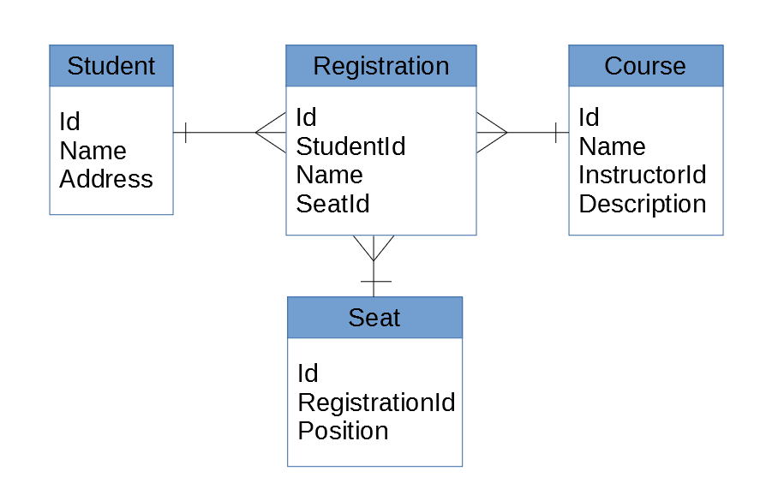
Relational Model
Relationships are created by dividing data into entity and attributes
Relationship is maintained by storing a common field
Information related to a particular type is stored in rows of a table
Simpler than the hierarchical and network model
High performance

Slide 12
Object-oriented Model
Data model is based on class representing real world objects.
generic objects can be defined and then reused in numerous application.
Provides features of Object Oriented Design like class, encapsulation, inheritance, polymorphism.
storage of complex data structures that cannot be easily stored using conventional database terminology.
Contain active object servers which support both distribution of data and distribution of work.
Easier navigation
Better concurrency control

Slide 13
Database Architecture
uses programming languages to design a particular type of software for businesses or organizations
focuses on the design, development, implementation and maintenance of computer programs that store and organize information for businesses, agencies and institutions.
database architect develops and implements software to meet the needs of users.
DBMS can be seen as either single tier or multi-tier classified as follows:
1-tier architecture : involves putting all of the required components on a single server
2-tier architecture : based on Client Server architecture.
3-tier architecture : mostly used in web applications and distributed applications(presentation, application and data tier).
n-tier architecture : divides an application into three tiers: logic , presentation and Data tier.

Slide 14
Database Management System
Software for creating and managing databases.
Accessed by multiple users, from multiple locations, in a controlled manner.
Can limit the data, a user can see, as well as how that user can view the data, providing many views of the single data.
Allows users to define the database, usually through Data Definition Language(DDL)
Allows users to insert, update, delete, and retrieve data from the database, usually through Data Manipulation Language (DML).
Provides controlled access to database including Security, Integrity, Concurrency.
Provides recovery control system, which restores the database to a previous consistent state following a hardware or software failure .
Eg : MSSQL, MySQL, PostgreSQL, Oracle, SQLite, IBM DB2.

